Slide 1
Cloud Computing SIT1304

Slide 2
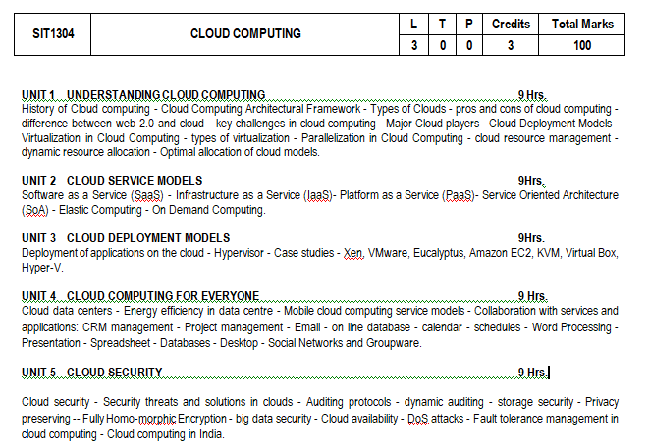
Syllabus

Slide 3
COURSE OUTCOMES
On completion of the course, student will be able to
CO1 : Comprehend the type, architecture and features of a given Cloud setup with its suitability for a given application.
CO2 : Compare the types of cloud services and connect to the service requirements of an application.
CO3 : Deploy an application on suitable cloud and make use of the suitable virtualization tool to create cloud infrastructure.
CO4 : Evaluate a cloud data centre and measure its energy efficiency.
CO5 : Appraise the Cloud security and the associated risks to protect the online and cloud infrastructure from external threats and third party attacks.
CO6 : Manage and collaborate cloud services with dynamic auditing.

Slide 4
TEXT / REFERENCE BOOKS
Cloud computing a practical approach - Anthony T.Velte, Toby J. Velte Robert Elsenpeter TATA McGraw - Hill, New Delhi - 2010
Cloud Computing: Web-Based Applications That Change the Way You Work and Collaborate Online - Michael Miller - Que 2008
Cloud Security: A Comprehensive Guide to Secure Cloud Computing, Ronald L. Krutz, Russell Dean Vines, Wiley-India, 2010

Slide 5
UNIT 1 UNDERSTANDING CLOUD COMPUTING
History of Cloud computing
Cloud Computing Architectural Framework
Types of Clouds
pros and cons of cloud computing
difference between web 2.0 and cloud
key challenges in cloud computing
Major Cloud players
Cloud Deployment Models
Virtualization in Cloud Computing
types of virtualization
Parallelization in Cloud Computing
cloud resource management
dynamic resource allocation
Optimal allocation of cloud models.

Slide 6
Computing
Centralized computing
Distributed computing
Cluster computing
Grid computing
Cloud computing

Slide 7
What is Cloud Computing?
Distributed computing on internet Or delivery of computing service over the internet.
Eg: ,Yahoo!, GMail, Hotmail-
Instead of running an e-mail program on your computer, you log in to a Web e-mail account remotely. The software and storage for your account doesn't exist on your computer -- it's on the service's computer cloud.
Notes:
In computer networking , cloud computing is a phrase used to describe a variety of computing concepts. Distributed computing on internet.

Slide 8

What is ?
Cloud computing is a technology that uses the internet and central remote servers to maintain data and applications.
A simple example of cloud computing is Yahoo email or Gmail etc
A style of computing where massively scalable (and elastic) IT-related capabilities are provided “as a service” to external customers using Internet technologies

Slide 9
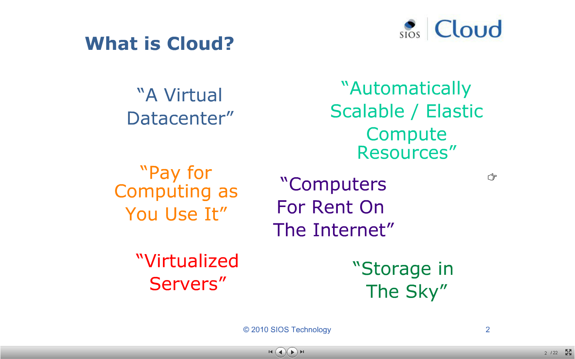

Slide 10
History
Concept evolved in 1950(IBM) called RJE (Remote Job Entry Process).
In 2006 Amazon provided First public cloud AWS(Amazon Web Service).

Slide 11
HISTORY of Cloud Computing - Evolution of Sharing on the Internet
Services Sharing
Cloud Computing
Everything as a service over the Web: SaaS,IaaS,PaaS, utility& Grid computing, IT se
-rvices,available, scalable, …
Resource Sharing
Grid Computing
Standards and software for sharing of
remote resources and collaboration
Mainly used for highly scalable HPC jobs
Information Sharing
The World Wide Web
HTML page format, HTTP protocol, and
Mosaic browser for document exchange
Initially in universities; worldwide adoption
Network Sharing
Inter-Networking and the Internet
Inter-Networking of regional networks with TCP/IP
Began to replace regional alternatives
Worldwide adoption – file transfer
Networking
Networks
Multiple regional networks linking computers
Initially at universities and national labs

Slide 12
Overview
Cloud Computing provides us a means by which we can access the applications as utilities, over the Internet.
It allows us to create, configure, and customize applications online.
With Cloud Computing users can access database resources via the internet from anywhere for as long as they need without worrying about any maintenance or management of actual resources.

Slide 13
What is Cloud?
The term Cloud refers to a Network or Internet. In other words, we can say that Cloud is something, which is present at remote location.
Cloud can provide services over network, i.e., on public networks or on private networks, i.e., WAN, LAN or VPN.
Applications such as e-mail, web conferencing, customer relationship management (CRM), all run in cloud.

Slide 14
What is Cloud Computing?
Cloud Computing refers to manipulating, configuring, and accessing the applications online.
It offers online data storage, infrastructure and application
Cloud Computing is both a combination of software and hardware based computing resources delivered as a network service.

Slide 15
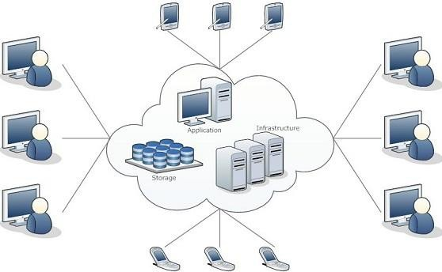
Cloud Computing Architecture

Slide 16
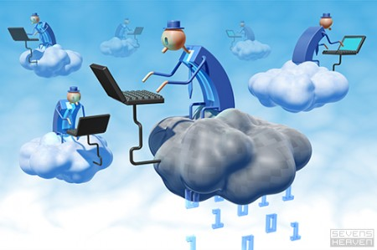
Cloud computing: Anything that involves delivering hosted services over the Internet.
"X as a Service" or "Anything as a Service " or “Everything as a Service (XaaS)”
These services are
IaaS: Infrastructure as a Service
PaaS: Platform as a Service
SaaS: Software as a Service
AaaS: Application as a Service
HaaS: Hardware as a Service
MaaS (Management as a Service),
CaaS (Communications as a Service)
DaaS (Data or Database or Desktop as a Service).
“Subscribe & Use -- Pay for what you use, based on QoS”

Slide 17
Basic Concepts
There are certain services and models working behind the scene making the cloud computing feasible and accessible to end users.
Following are the working models for cloud computing:
Deployment Models
Service Models

Slide 18
Deployment Models
Deployment models define the type of access to the cloud, i.e., how the cloud is located?
Cloud can have any of the four types of access:
Public, Private, Hybrid and Community.

Slide 19
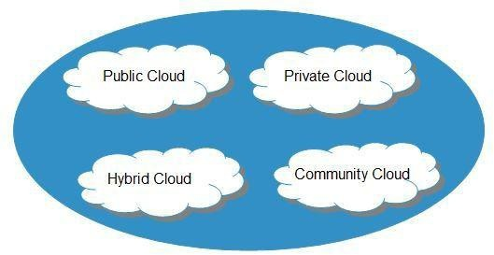

Slide 20
PUBLIC CLOUD : The Public Cloud allows systems and services to be easily accessible to the general public. Public cloud may be less secure because of its openness, e.g., e-mail.
PRIVATE CLOUD : The Private Cloud allows systems and services to be accessible within an organization. It offers increased security because of its private nature.
COMMUNITY CLOUD : The Community Cloud allows systems and services to be accessible by group of organizations.
HYBRID CLOUD : The Hybrid Cloud is mixture of public and private cloud. However, the critical activities are performed using private cloud while the non-critical activities are performed using public cloud.

Slide 21
Service Models
Service Models are the reference models on which the Cloud Computing is based.
These can be categorized into three basic service models as listed below:
Infrastructure as a Service (IaaS)
Platform as a Service (PaaS)
Software as a Service (SaaS)

Slide 22
Infrastructure as a Service (IaaS)
IaaS is the delivery of technology infrastructure as an on demand scalable service.
IaaS provides access to fundamental resources such as physical machines, virtual machines, virtual storage, etc.
Usually billed based on usage
Usually multi tenant virtualized environment
Can be coupled with Managed Services for OS and application support

Slide 23






IaaS Examples

Slide 24
Platform as a Service (PaaS)
PaaS provides the runtime environment for applications, development & deployment tools, etc.
PaaS provides all of the facilities required to support the complete life cycle of building and delivering web applications and services entirely from the Internet.
Typically applications must be developed with a particular platform in mind
Multi tenant environments
Highly scalable multi tier architecture

Slide 25


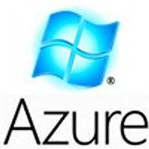



PaaS Examples

Slide 26
Software as a Service (SaaS)
SaaS model allows to use software applications as a service to end users.
SaaS is a software delivery methodology that provides licensed multi-tenant access to software and its functions remotely as a Web-based service.
•
•
•
Usually billed based on usage
Usually multi tenant environment
Highly scalable architecture

Slide 27

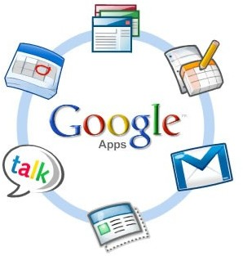

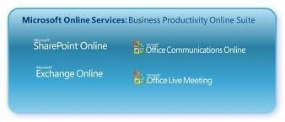

SaaS Examples

Slide 28
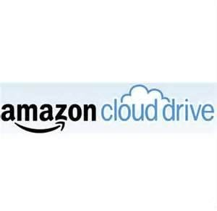



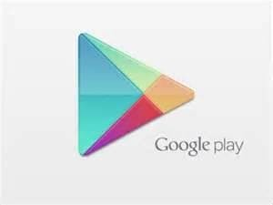

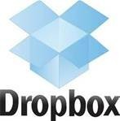





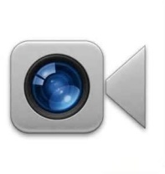



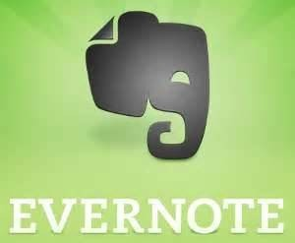


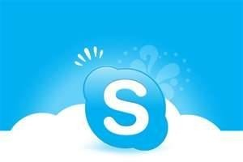

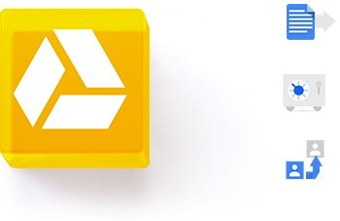
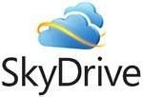

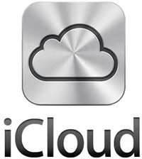
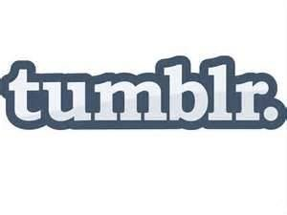



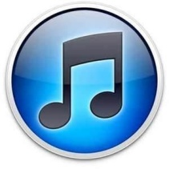




Do you Use the Cloud?

Slide 29
Advantages
•
•
•
•
•
•
•
•
•
•
•
Lower computer costs
Improved performance
Reduced software costs
Instant software updates
Improved document format compatibility
Unlimited storage capacity
Increased data reliability
Universal document access
Latest version availability
Easier group collaboration
Device independence

Slide 30
Disadvantages
•
•
•
•
•
•
Requires a constant Internet connection
Does not work well with low-speed connections Features might be limited
Can be slow
Stored data can be lost
Stored data might not be secure

Slide 31
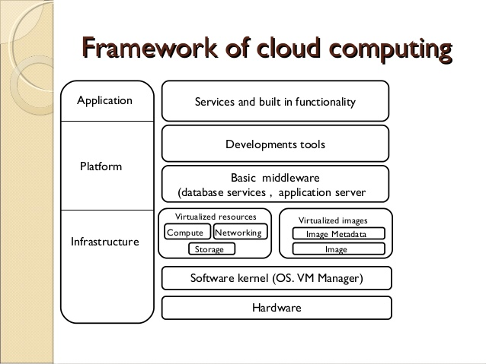
Cloud Computing Architectural Framework

Slide 32

Cloud Storage
•
Create an Account User name and password.
•
Content lives with the account in the cloud.
•
Log onto any computer with Wi-Fi to find your content

Slide 33
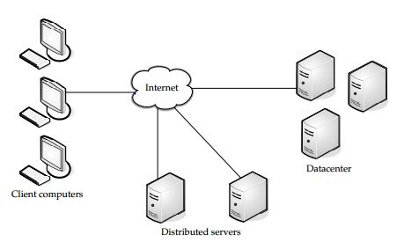
Cloud Components
It has three components
1.) Client computers
2.) Distributed Servers
3.) Datacenters

Slide 34
Clients
Clients are the device that the end user interact with cloud.
three types of clients:
1.) Mobile
2.) Thick
3.) Thin (Most Popular)

Slide 35
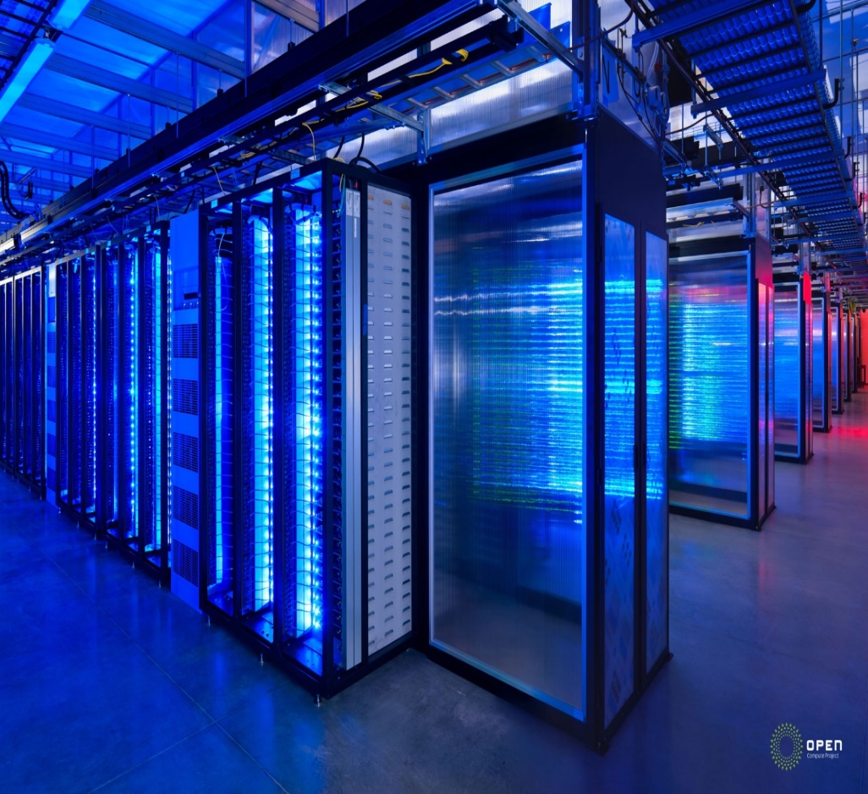
Datacenter
It is collection of servers where application is placed and is accessed via internet.

Slide 36
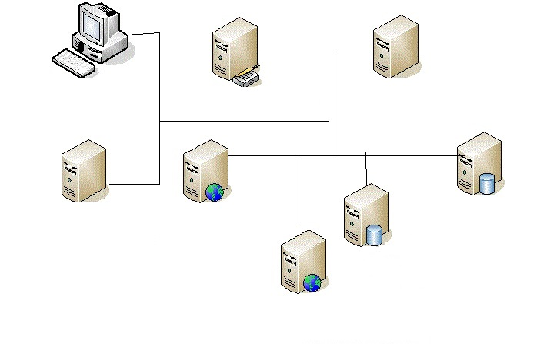
Distributed servers
Often servers are in geographically different places, but server acts as if they are working next to each other.

Slide 37
Central Server
It Administers the system such as monitoring traffic, client demands to ensure everything runs smoothly.
It uses a special type of software called Middleware.
Middleware allow computer to communicate each other.

Slide 38
key challenges in cloud computing
enabling future IOS
Support for Application Elasticity.
Quality of Service Assurance.
Cloud Infrastructure Scalability.
Cloud Reliability.
Cloud Privacy & Security.
Efficient Energy Resource Management.
Cloud Federation.
Cloud Interoperability & Portability

Slide 39
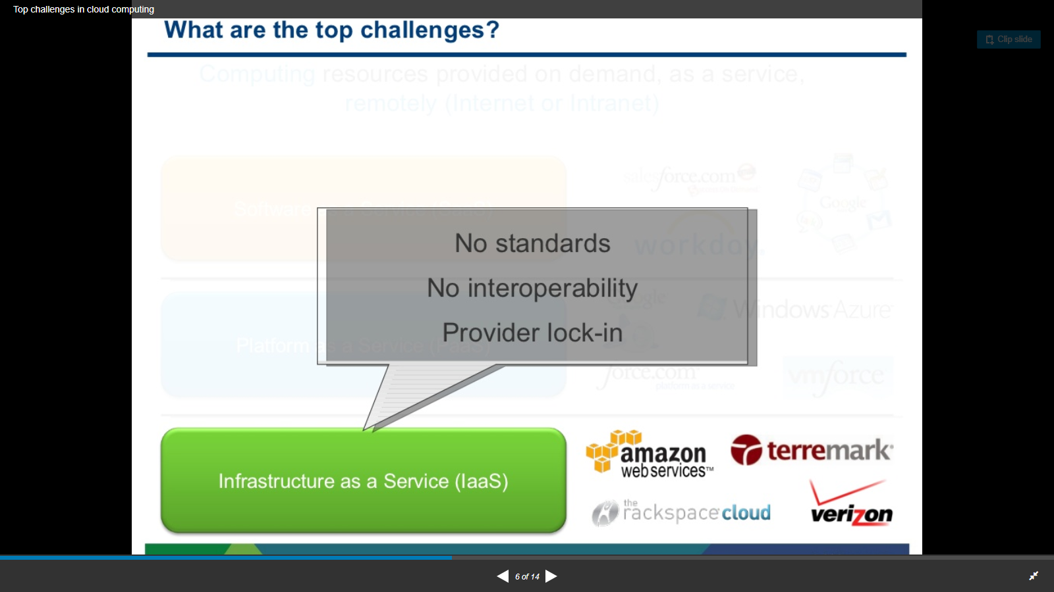

Slide 40
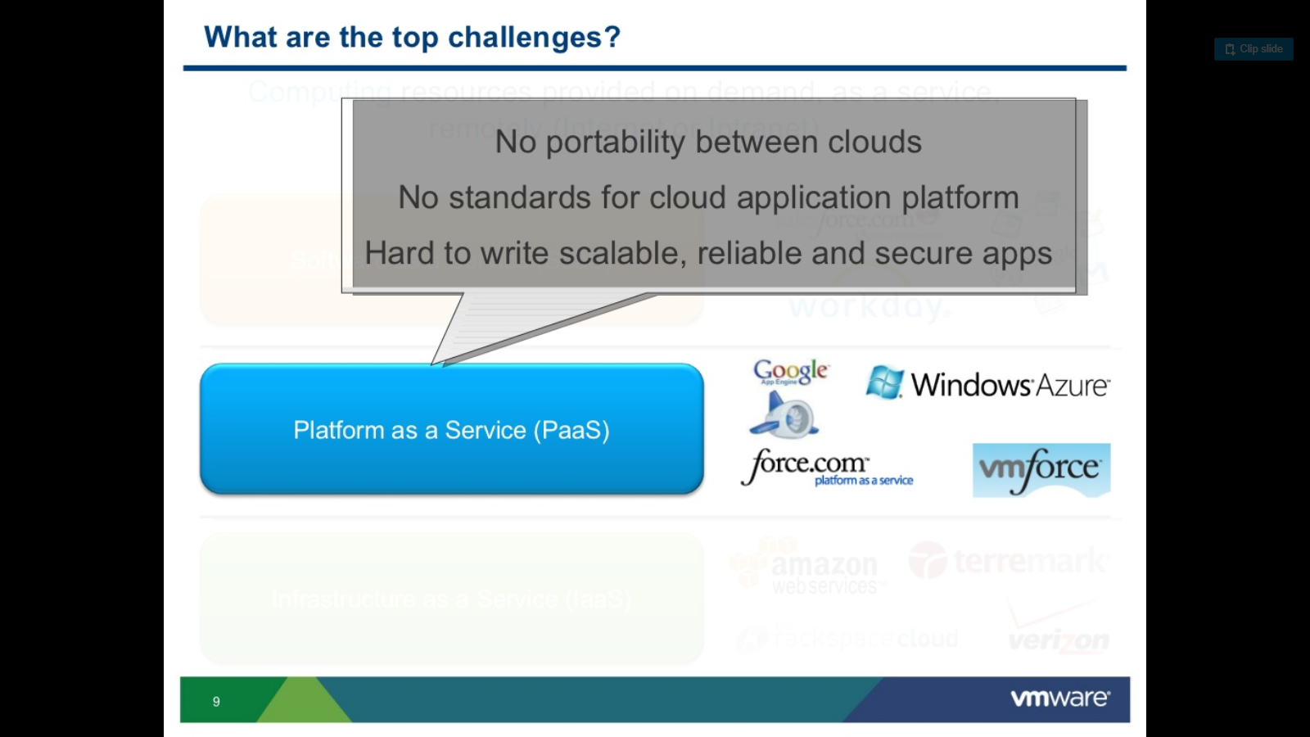

Slide 41
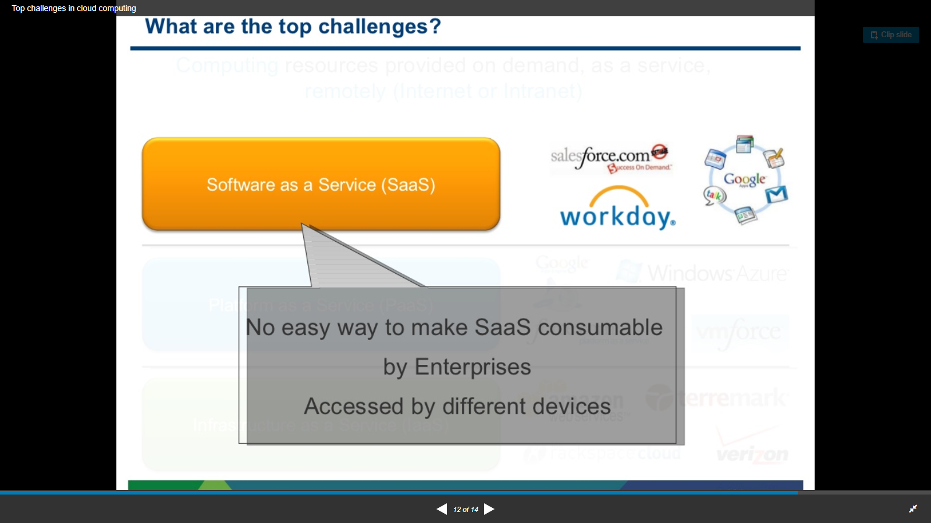

Slide 42
MAJOR CLOUD PLAYERS

Slide 43
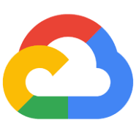
Google Cloud Platform
Computer application
Google Cloud Platform, offered by Google, is a suite of cloud computing services that runs on the same infrastructure that Google uses internally for its end-user products,
such as Google Search and YouTube
Initial release: April 7, 2008; 10 years ago
License: Proprietary

Slide 44
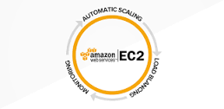
Amazon Elastic Compute Cloud
Computer application
Amazon Elastic Compute Cloud forms a central part of Amazon.com's cloud-computing platform, Amazon Web Services, by allowing users to rent virtual computers on which to run their own computer applications
Initial release: August 25, 2006; 12 years ago (public beta)
Original author(s): Amazon.com, Inc
Developed by: Amazon.com
License: Proprietary software

Slide 45
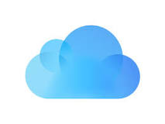
iCloud
Downloadable software
iCloud is a cloud storage and cloud computing service from Apple Inc. launched on October 12, 2011. As of February 2016, the service had 782 million users.
Developed by: Apple
Initial release date: 12 October 2011

Slide 46
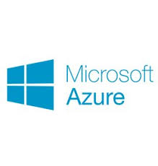
Microsoft Azure
Computer application
Microsoft Azure is a cloud computing service created by Microsoft for building, testing, deploying, and managing applications and services through a global network of Microsoft-managed data centres.
Developed by: Microsoft Corporation
Initial release date: 1 February 2010
Operating system: Linux, Microsoft Windows
License: Closed source for platform, Open source for client SDKs
Parent company: Microsoft Corporation

Slide 47

G Suite
Computer software
G Suite is a brand of cloud computing, productivity and collaboration tools, software and products developed by Google, first launched on August 28, 2006 as "Google Apps for Your Domain".
Developed by: Google
License: Trialware (Retail, volume licensing, Software as a service)
Platform: Gmail, Calendar, Hangouts, Drive, Docs, Sheets, Slides, Sites, Jamboard, App Maker and Vault
Initial release: August 28, 2006; 12 years ago (as Google Apps for Your Domain)
Parent company: Google

Slide 48
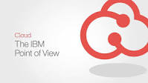
IBM cloud computing
Computer software
IBM cloud computing is a set of cloud computing services for business offered by the information technology company IBM.

Slide 49
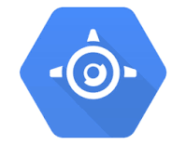
Google App Engine
Computer application
Google App Engine is a web framework and cloud computing platform for developing and hosting web applications in Google-managed data centers. Applications are sandboxed and run across multiple servers.
Developed by: Google
Platform: little-endian 32bits
Initial release: April 7, 2008; 10 years ago
Stable release: 1.9.63 / 27 February 2018
Operating system: linux (glibc), Windows
Written in: Python, Java, Go, PHP, Node.js

Slide 50
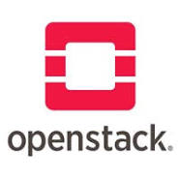
OpenStack
Software
OpenStack is a free and open-source software platform for cloud computing, mostly deployed as infrastructure-as-a-service, whereby virtual servers and other resources are made available to customers.
Written in: Python
License: Apache License 2.0
Stable release: Rocky (2018.08.30) / 30 August 2018; 4 months ago
Initial release date: 21 October 2010

Slide 51

Kubernetes
Computer application
Kubernetes is an open-source container-orchestration system for automating deployment, scaling and management of containerized applications. It was originally designed by Google and is now maintained by the Cloud Native Computing Foundation.
Stable release: 1.13 / December 3, 2018; 32 days ago
License: Apache License 2.0
Developed by: Linux Foundation
Initial release: 7 June 2014; 4 years ago
Written in: Go

Slide 52
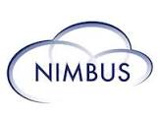
Nimbus
Software
Nimbus is a toolkit that, once installed on a cluster, provides an infrastructure as a service cloud to its client via WSRF-based or Amazon EC2 WSDL web service APIs. Nimbus is free and open-source software, subject to the requirements of the Apache License, version 2.
Operating system: Linux
Platform: Xen + KVM
License: Apache License version 2
Initial release: TP2.2 2009-01-09
Developer(s): Kate Keahey, Tim Freeman, et al
Written in: Java, Python

Slide 53

Apache CloudStack
Computer software
CloudStack is open-source cloud computing software for creating, managing, and deploying infrastructure cloud services. It uses existing hypervisors such as KVM, VMware vSphere, VMware ESXi, VMware vCenter, and XenServer/XCP for virtualization.
Platform: Java
Stable release: 4.11.1.0 / July 2, 2018; 5 months ago
Developed by: Apache Software Foundation
Written in: Java
License: Apache License 2
Original authors: Apache CloudStack, Citrix Systems

Slide 54

OpenNebula
Computer software
OpenNebula is a cloud computing platform for managing heterogeneous distributed data center infrastructures. The OpenNebula platform manages a data center's virtual infrastructure to build private, public and hybrid implementations of infrastructure as a service. Wikipedia
License: Apache License version 2
Platform: Hypervisor (Xen, KVM, VMware, vCenter)
Operating system: Linux
Stable release: 5.6.2 / 10 October 2018; 2 months ago
Initial release: March 1, 2008; 10 years ago
Written in: C++, C, Ruby, Java, lex, Yacc

Slide 55

Eucalyptus
Computer software
Eucalyptus is a paid and open-source computer software for building Amazon Web Services-compatible private and hybrid cloud computing environments, originally developed by the company Eucalyptus Systems. Eucalyptus is an acronym for Elastic Utility Computing Architecture for Linking Your Programs To Useful Systems.
Operating system: GNU/Linux, can host Linux and Windows VMs
Platform: Hypervisor (KVM, Xen, VMware)
Stable release: 4.4.3 (April 30, 2018; 8 months ago)
Initial release: 1.0 – May 29, 2008; 10 years ago
Developer(s): Eucalyptus Systems, Inc
Written in: Java, C

Slide 56
Virtualization in Cloud Computing

Slide 57
Virtualization in Cloud Computing
In computing, virtualization means to create a virtual version of a device or resource, such as a server, storage device, network or even an operating system where the framework divides the resource into one or more execution environments.
It involves using specialized software to create a virtual or software-created version of a computing resource rather than the actual version of the same resource.

Slide 58
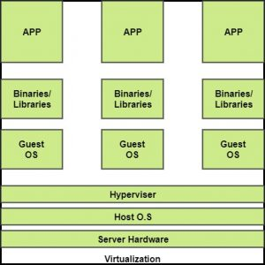
The machine on which the virtual machine is going to be build is known as Host Machine and that virtual machine is referred as a Guest Machine.

Slide 59
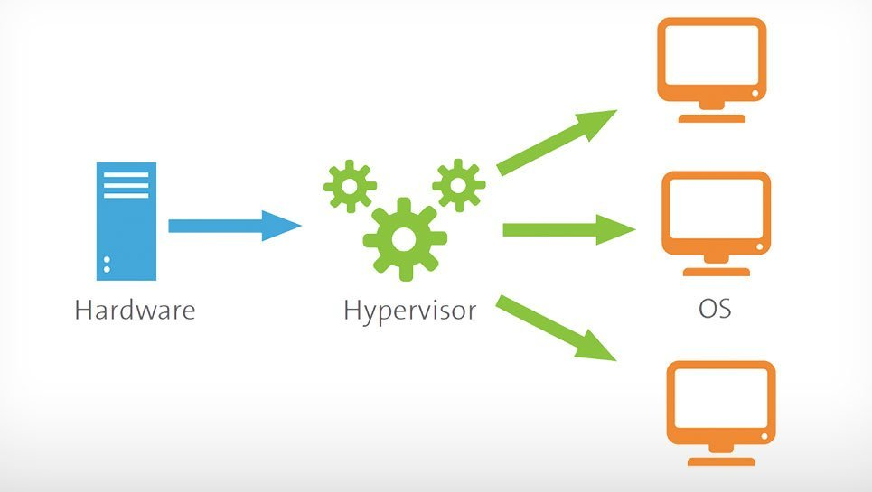
Hypervisor
A hypervisor or virtual machine monitor (VMM) is computer software, firmware or hardware that creates and runs virtual machines.
A computer on which ahypervisor runs one or more virtual machines is called a host machine, and each virtual machine is called a guest machine.

Slide 60
BENEFITS OF VIRTUALIZATION
1.More flexible and efficient allocation of resources. 2.Enhance development productivity. 3.It lowers the cost of IT infrastructure. 4.Remote access and rapid scalability. 5.High availability and disaster recovery. 6.Pay per use of the IT infrastructure on demand. 7.Enables running multiple operating system.

Slide 61
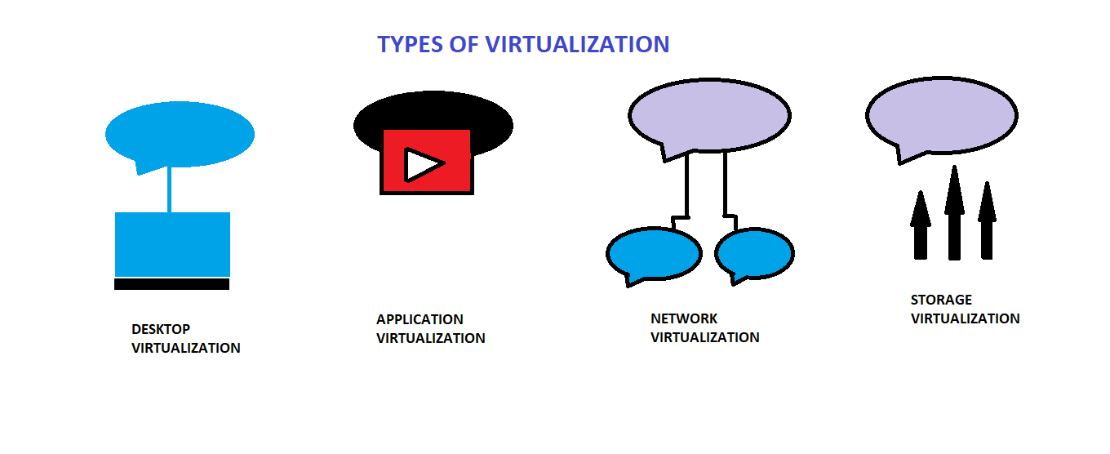
Types of Virtualization:
Application Virtualization
Network Virtualization
Desktop Virtualization
Storage Virtualization

Slide 62
Application Virtualization
Application virtualization helps user to have a remote access of an application from a server. The server stores all personal information and other characteristics of the application, but can still run on a local workstation through internet.
Example of this would be a user who needs to run two different versions of the same software.
Technologies that use application virtualization are hosted applications and packaged applications.

Slide 63
2.Network Virtualization
The ability to run multiple virtual networks that each has a separate control and data plan.
It co-exist together on top of one physical network.
It can be managed by individual parties that potentially confidential to each other.
Network virtualization, provides a facility to create and provision virtual networks—logical switches, routers, firewalls, load balancer, Virtual Private Network (VPN), and workload security within days or even in weeks.

Slide 64
Desktop Virtualization
Desktop virtualization allows the users’ OS to be remotely stored on a server in the data center.
It allows the user to access their desktop virtually, from any location by different machine.
Users who wants specific operating systems other than Windows Server will need to have a virtual desktop.
Main benefits of desktop virtualization are user mobility, portability, easy management of software installation, updates and patches.

Slide 65
4.Storage Virtualization
Storage virtualization is an array of servers that are managed by a virtual storage system.
The servers aren’t aware of exactly where their data is stored, and instead function more like worker bees in a hive.
It makes managing storage from multiple sources to be managed and utilized as a single repository. storage virtualization software maintains smooth operations, consistent performance and a continuous suite of advanced functions despite changes, break down and differences in the underlying equipment.

Slide 66
Parallelization in Cloud Computing
Parallel computing is a type of computing architecture in which several processors execute or process an application or computation simultaneously.
Parallelization is the act of designing a computer program or system to process data in parallel. ... If a computer program or system is parallelized, it breaks a problem down into smaller pieces that can each independently be solved at the same time by discrete computing resources.

Slide 67
CLOUD RESOURCE MANAGEMENT (CRM)

Slide 68
Cloud Computing is a new era of remote computing / Internet based computing where one can access their personal resourceseasily from any computer through Internet. ...
It contains large number of shared resources. So Resource Management is always a major issue in cloud computing like any othercomputing paradigm.
Cloud computing has emerged as a popular computing paradigm for hosting large computing systems and services.
Recently, significant research is carried out on Cloud Resource Management (CRM) techniques that focus on the efficient sharing of cloud resources among multiple users.

Slide 69
Resource management is a core function required for any cloud system, and inefficient resource management has a direct negative effect on performance and cost, while it can also indirectly affect system functionality, becoming too expensive or ineffective due to poor performance.

Slide 70

Resource management and scheduling
 Critical function of any man-made system.
 It affects the three basic criteria for the evaluation of a system:
◻◻ Functionality.
◻◻ Performance.
◻◻ Cost.
 Scheduling in a computing system →→ deciding how to allocate resources of a system, such as CPU cycles, memory, secondary storage space, I/O and network bandwidth, between users and tasks.
 Policies and mechanisms for resource allocation.
◻◻ Policy →→ principles guiding decisions.
◻◻ Mechanisms →→ the means to implement policies.

Slide 71

Motivation
 Cloud resource management .
◻◻ Requires complex policies and decisions for multi-objective optimization.
◻◻ It is challenging - the complexity of the system makes it impossible to have accurate global state information.
◻◻ Affected by unpredictable interactions with the environment, e.g., system failures, attacks.
◻◻ Cloud service providers are faced with large fluctuating loads which challenge the claim of cloud elasticity.
 The strategies for resource management for IaaS, PaaS, and SaaS are different.

Slide 72

Cloud resource management (CRM) policies
Admission control →→ prevent the system from accepting workload in violation of high-level system policies.
Capacity allocation →→ allocate resources for individual activations of a service.
Load balancing →→ distribute the workload evenly among the servers.
Energy optimization →→ minimization of energy consumption.
Quality of service (QoS) guarantees →→ ability to satisfy timing or other conditions specified by a Service Level Agreement.

Slide 73

Mechanisms for the implementation of resource management policies
 Control theory →→ uses the feedback to guarantee system stability and predict transient behavior.
 Machine learning →→ does not need a performance model of the system.
 Utility-based →→ require a performance model and a mechanism to correlate user-level performance with cost.
 Market-oriented/economic →→ do not require a model of the system, e.g., combinatorial auctions for bundles of resources.

Slide 74

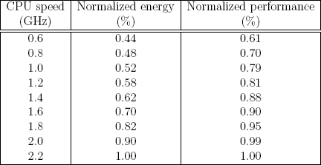
Tradeoffs
 To reduce cost and save energy we may need to concentrate the load on fewer servers rather than balance the load among them.
 We may also need to operate at a lower clock rate; the performance decreases at a lower rate than does the energy.

Slide 75


